Slide 1





English
Play

Slide 2






Who’s Watching?
Danh Đức
Long Lê
Nguyên Hiệu
Ngọc Sang
Thanh Quân
Start

Slide 3
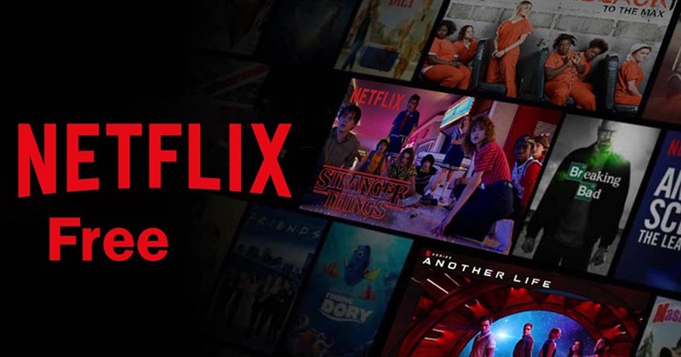
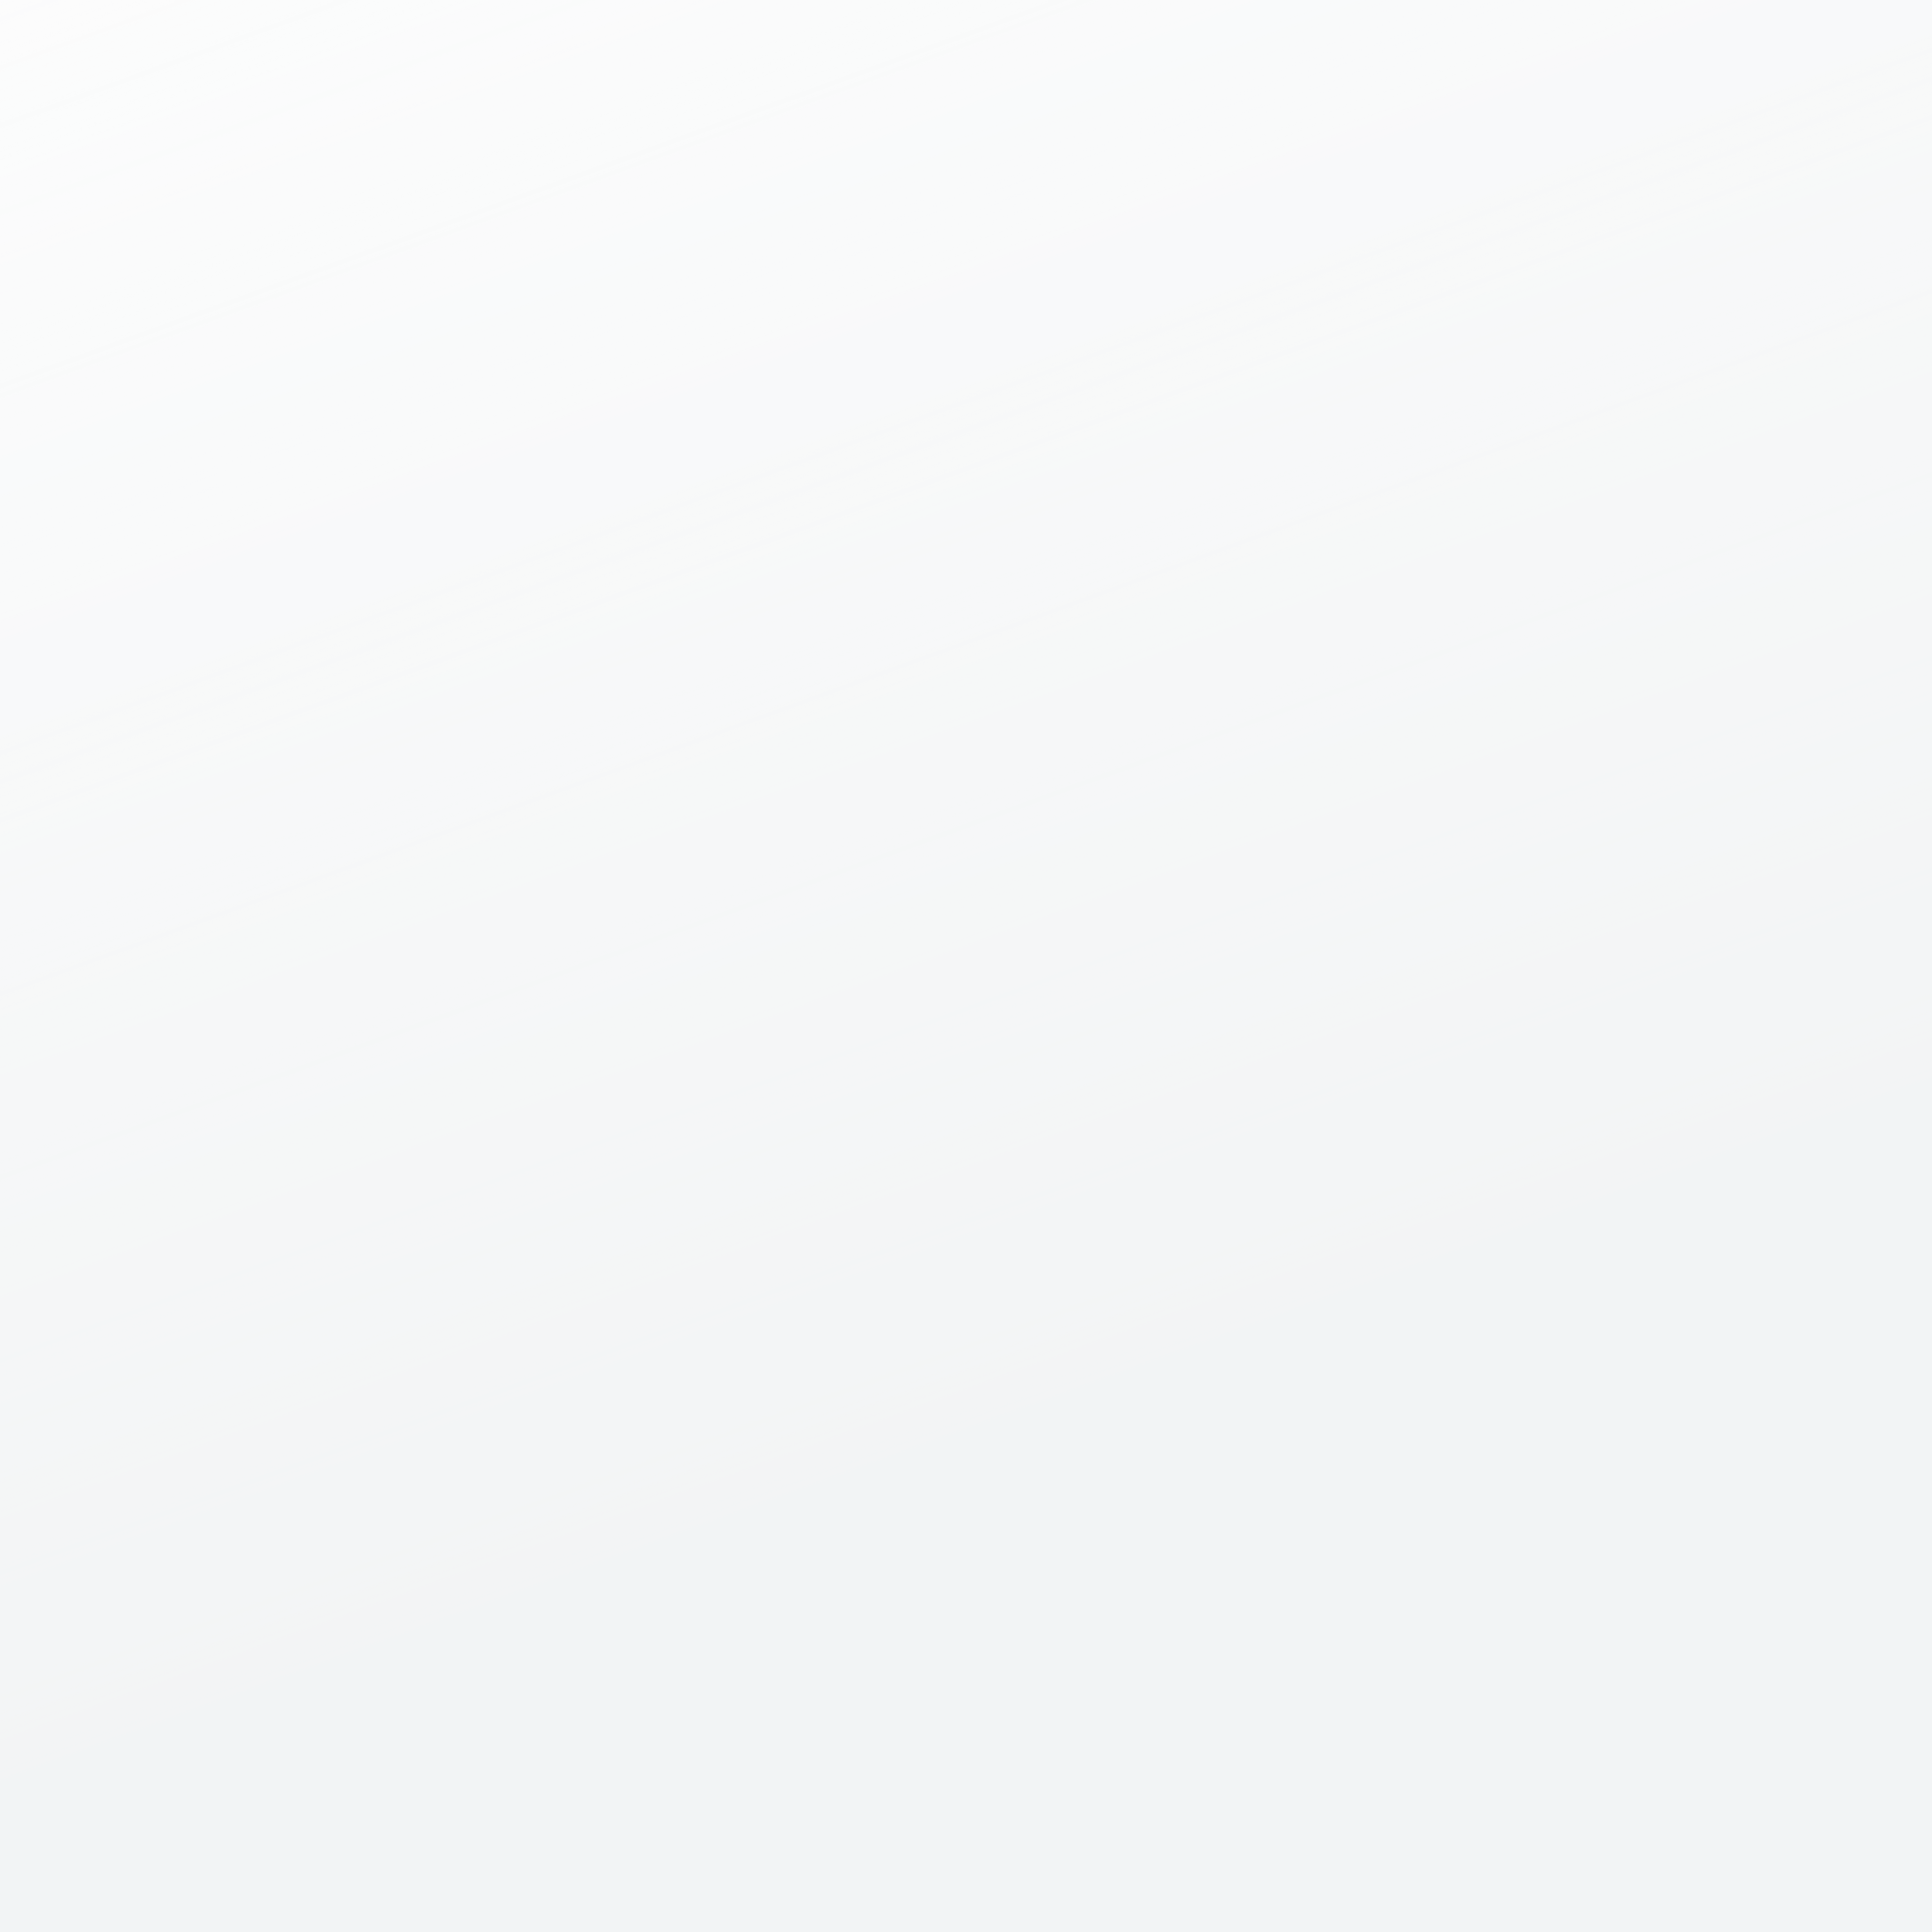
CONTENT
01
02
03
INTRODUCTION
TASK TIMELINE
METHODOLOGY
04
05
06
RESULT
CONCLUSION
REFERENCES

Slide 4

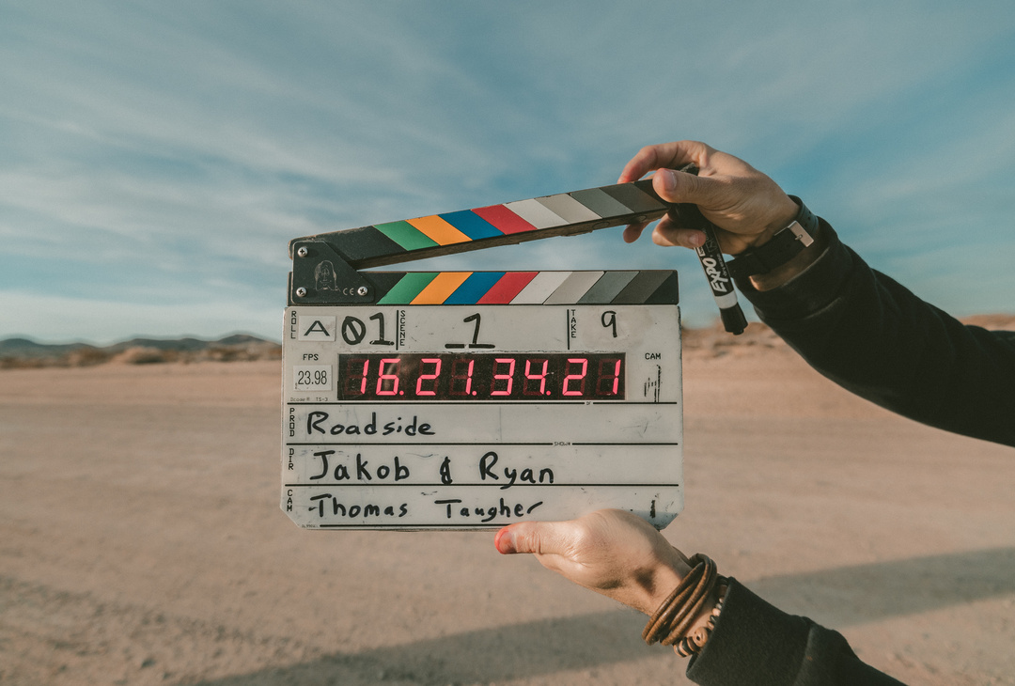

i. intrODUCTION
❖ Scene Overview
Content Growth
A Closer Lock
Shifting the Focus
This scene visualizes the increase in Netflix's content over time, showing a timeline on the x-axis and the count of Movies and TV Shows on the y-axis.
This scene highlights the countries that produce the most content for Netflix, emphasizing the United States and India.
This scene examines the evolution of Netflix's content distribution based on age ratings.

Slide 5

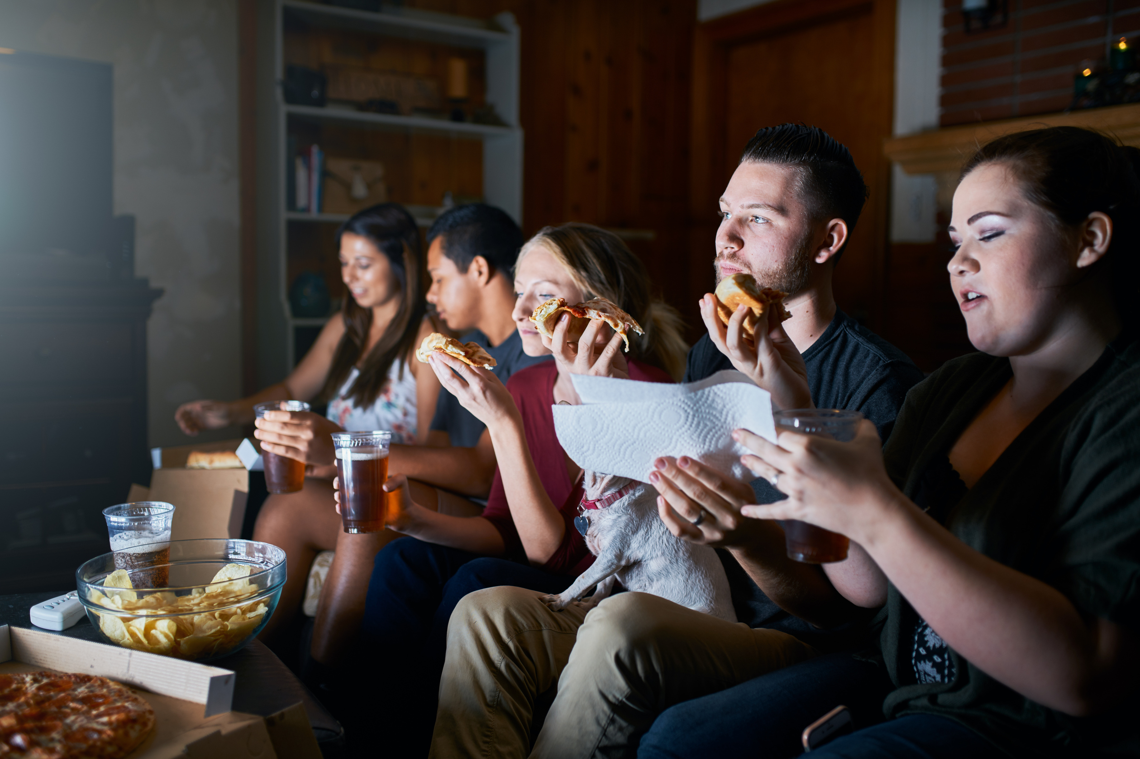
guess the
PURPOSE
#1
Question
This project provides a comprehensive summary of Netflix's content evolution.
The overview highlights the main aspects of how Netflix's content has changed over time, which will be visualized and analyzed.
Answer

Slide 6

guess the
GOAL
Process data to identify necessary attributes for visualization.
Manage and adjust charts using D3.js libraries for better alignment with potential future alterations.

Slide 7

guess the
TECHNIQUE & TOOLS USED
#1
IDE for web programming: Visual Studio Code - HTML/CSS/D3.js.
#2
Draft the UI of the dashboard: Figma

Slide 8

2. TIMELINE
Phase | Week
Planning | 1
Data Pulling | 2
Preprocessing Data | 3
Conceptual Design | 5-8
Implementing Design | 8-13
Presentation | 14

Slide 9

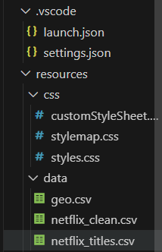
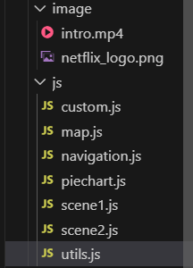
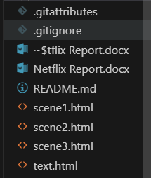
II.METHODOLOGY
1. Project Structure

Slide 10
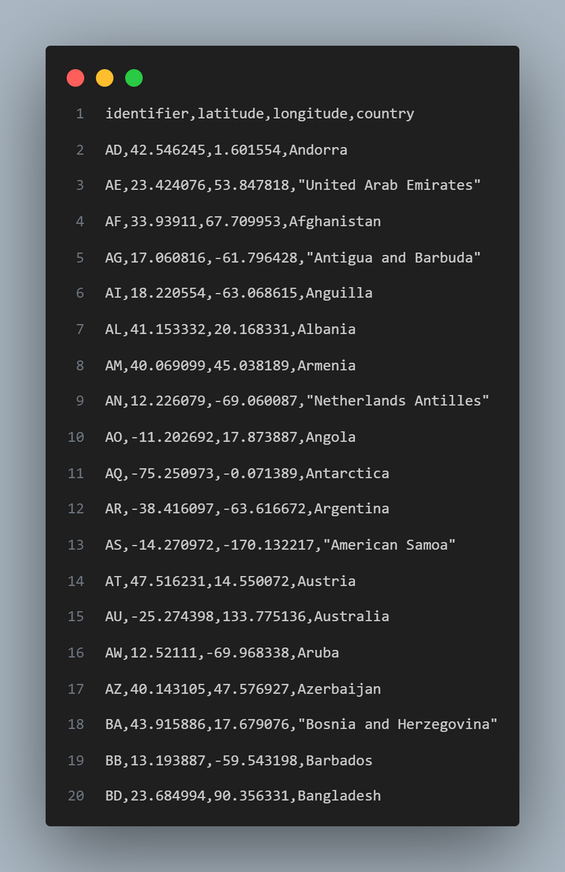
II.METHODOLOGY
2. Cleaning Data

Slide 11
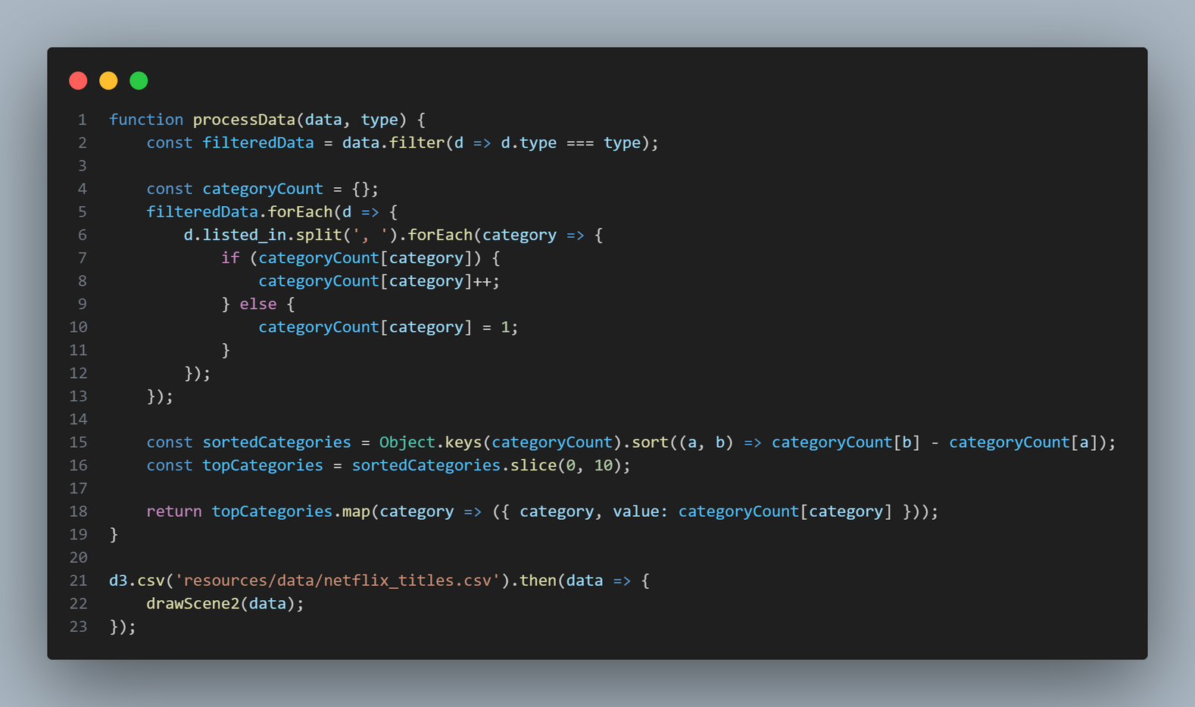
2. Cleaning Data

Slide 12
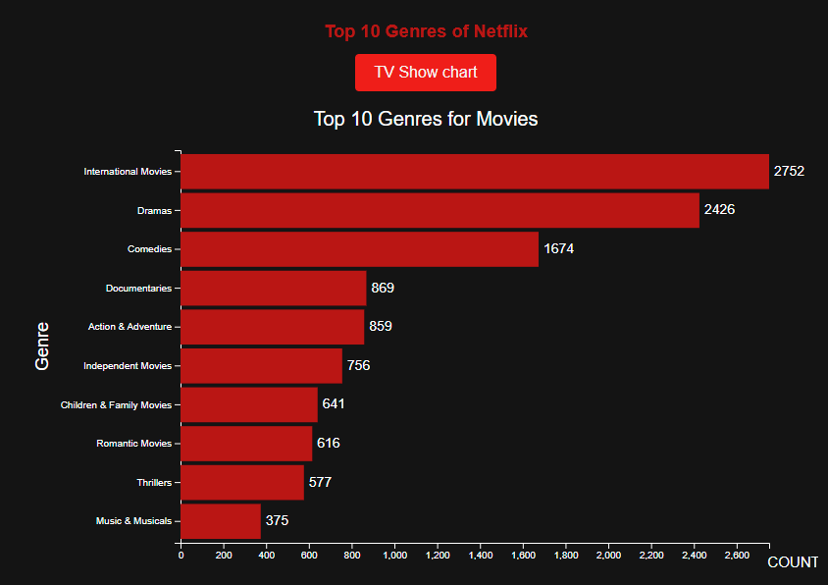

2. Cleaning Data
The data we got will look like this:
Movies Chart

Slide 13
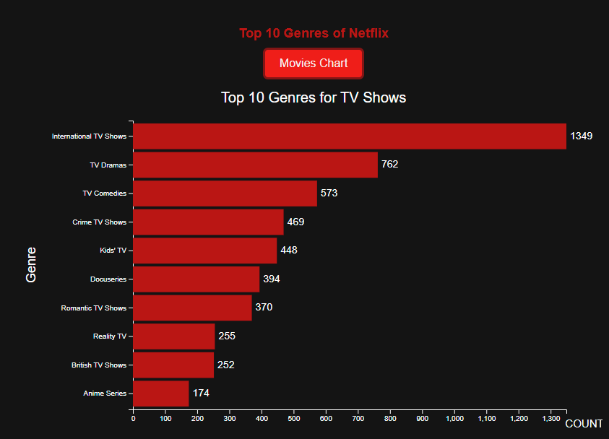

2. Cleaning Data
The data we got will look like this:
TV Show Chart

Slide 14
3. Chart usage
Chart name | Purpose | Description
Pie chart | To compare the number of TV Shows and Movies viewers | Compare using requirements between TV Shows and Movies of users from Netflix
Area Chart | To show trends over time, compare magnitudes, and visualize cumulative totals | The number of TV Shows and Movies added to a platform over a timeline from 2008 to 2021.

Slide 15
3. Chart usage
Chart name | Purpose | Description
Horizontal Bar Charts | View ranking of the minimum degree requirement | The horizontal bar chart illustrates how popular each film type in Netflix
Bubble Charts | To visualize and compare relationships between the number of users in each countries. | Displays a world map with various red circles of different size of TV Shows and Movies in each countries

Slide 16


4. IMPLEMENTATION WITH D3.JS

Slide 17
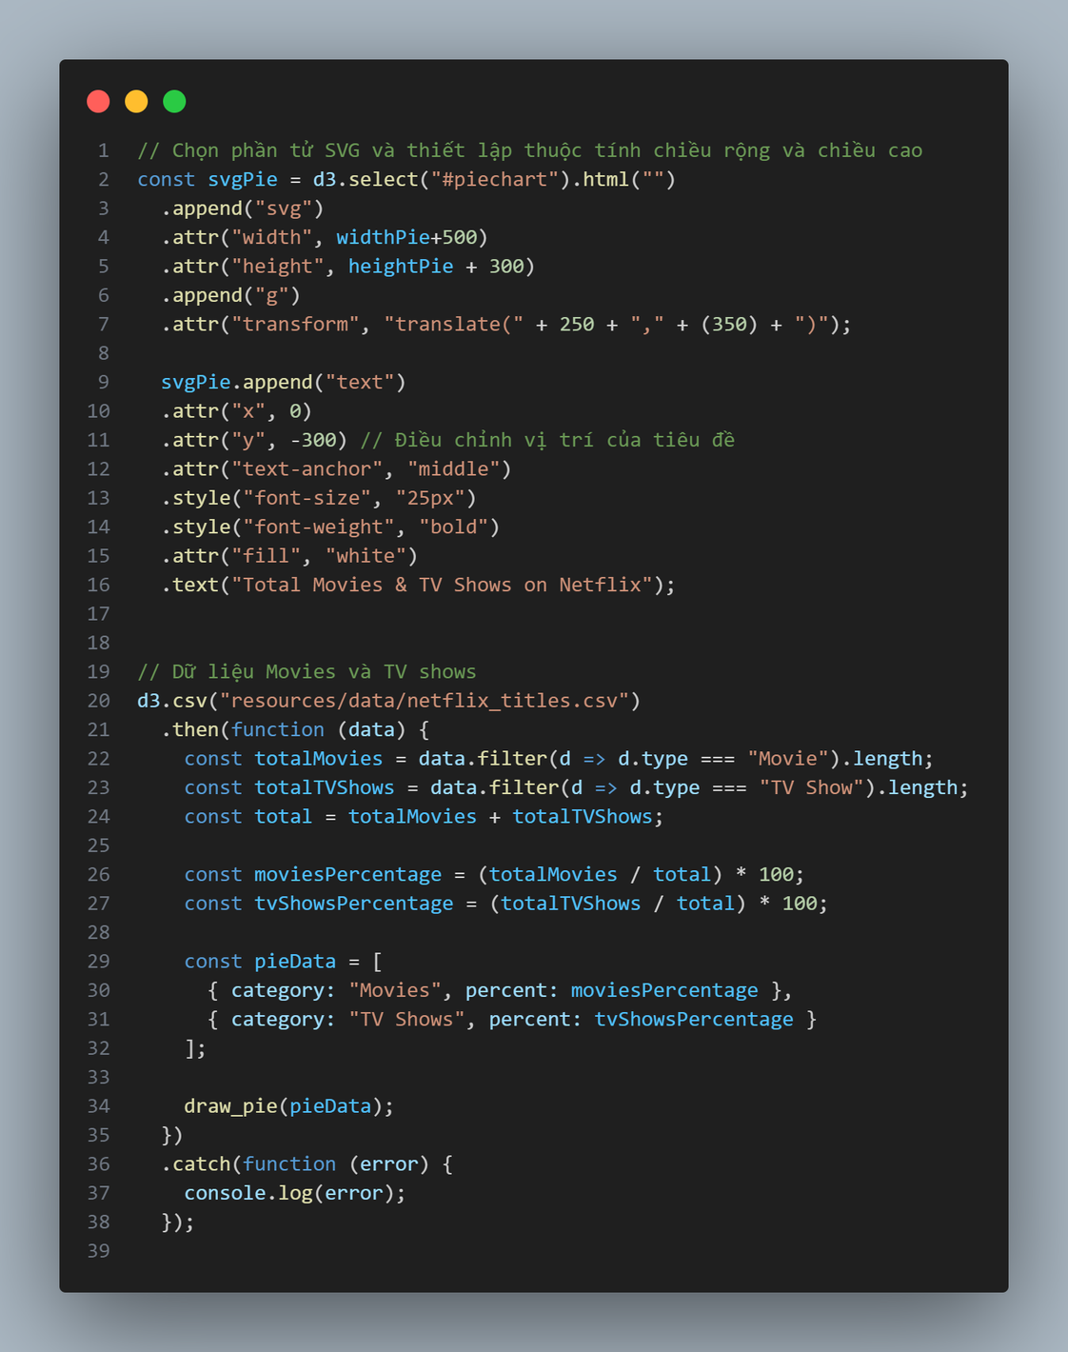
PIE CHART

Slide 18
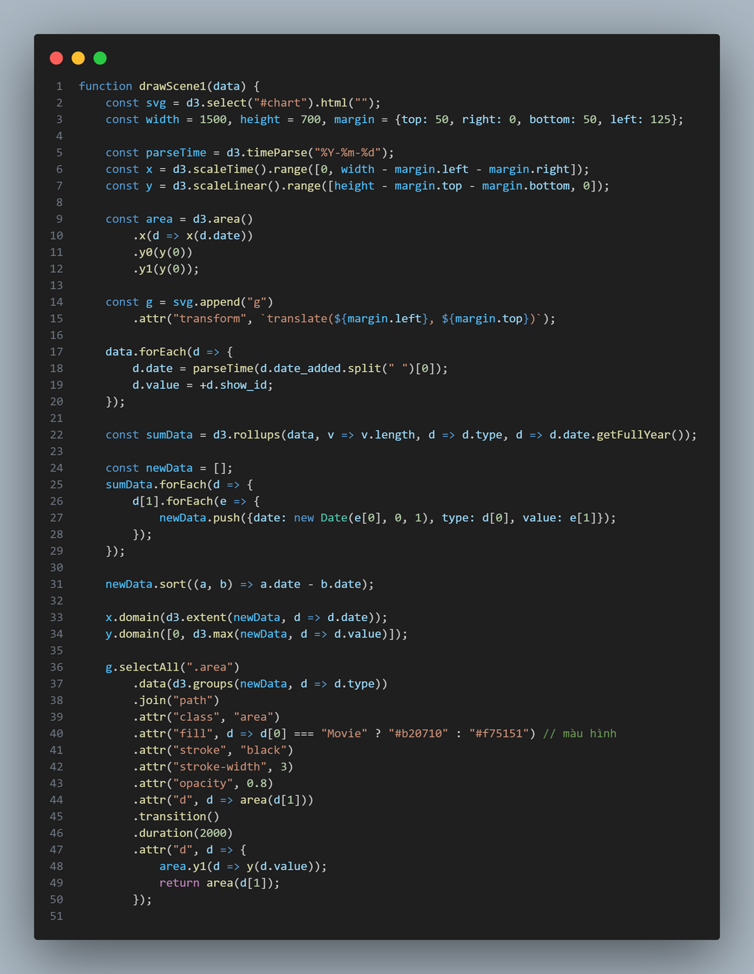
AREA CHART

Slide 19
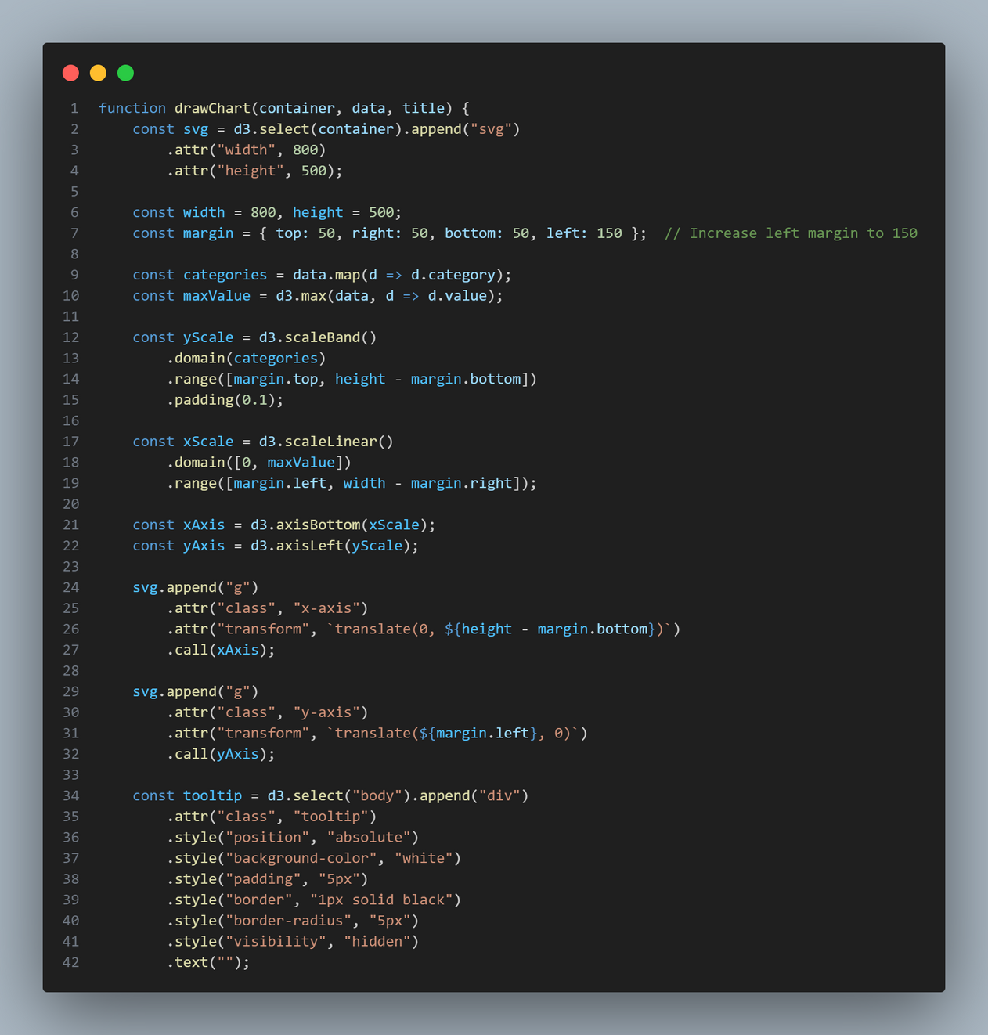
HORIZONTAL BAR CHART

Slide 20
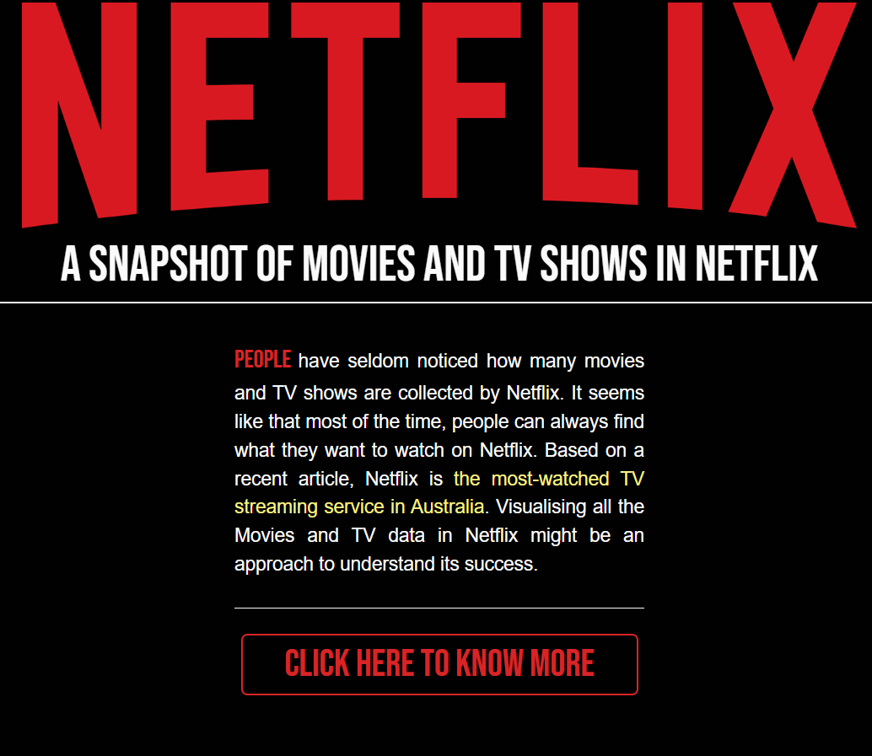
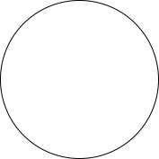
IV. RESULT

Slide 21
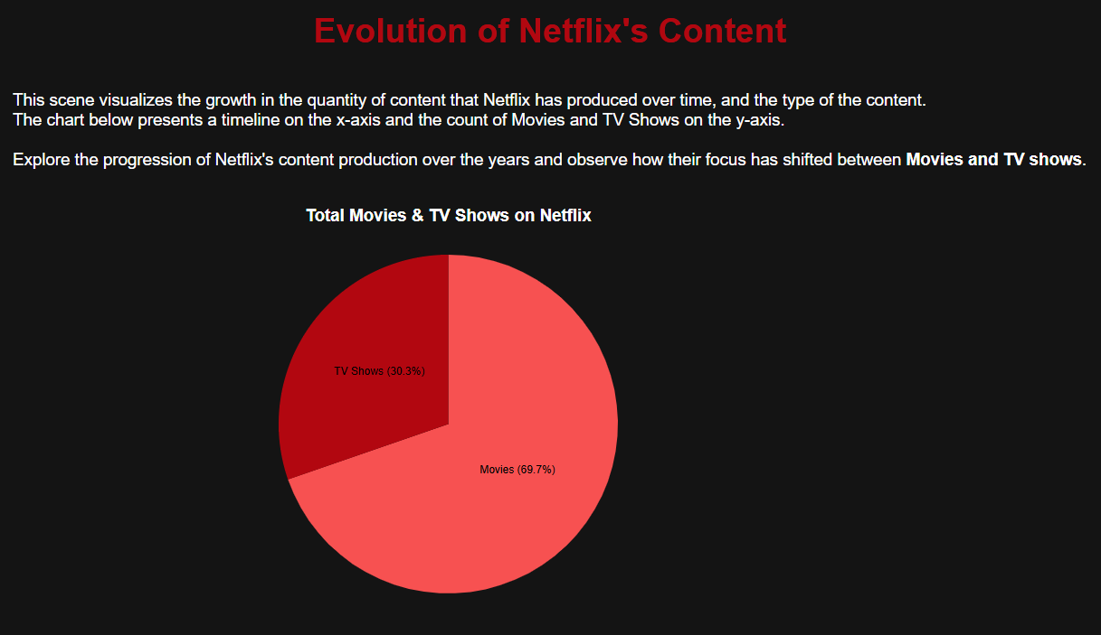
FIRST PAGE

Slide 22
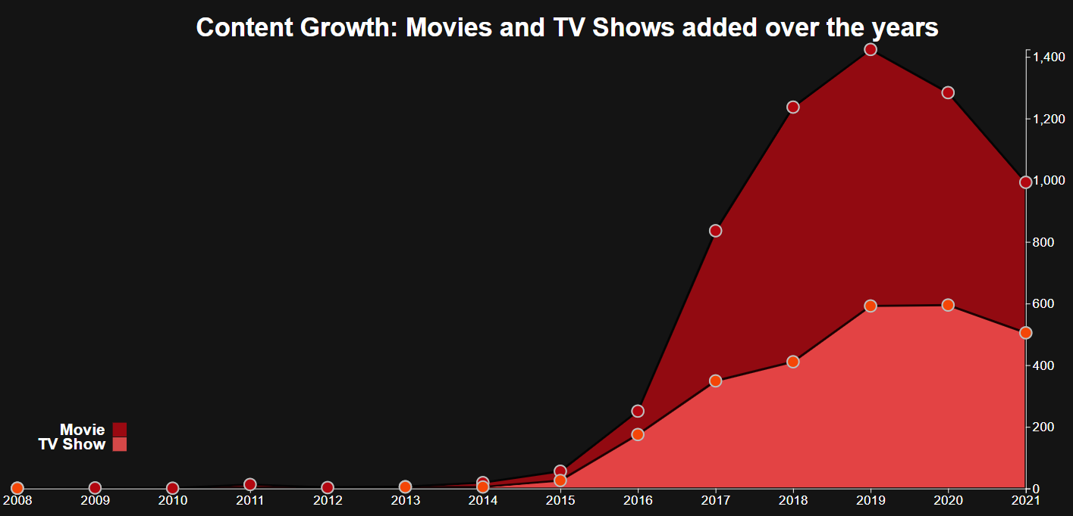
FIRST PAGE

Slide 23
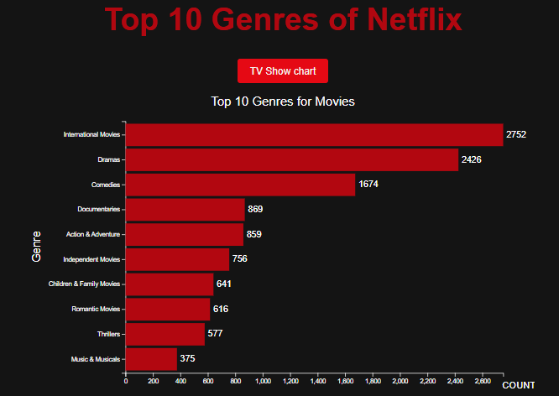
SECOND PAGE

Slide 24
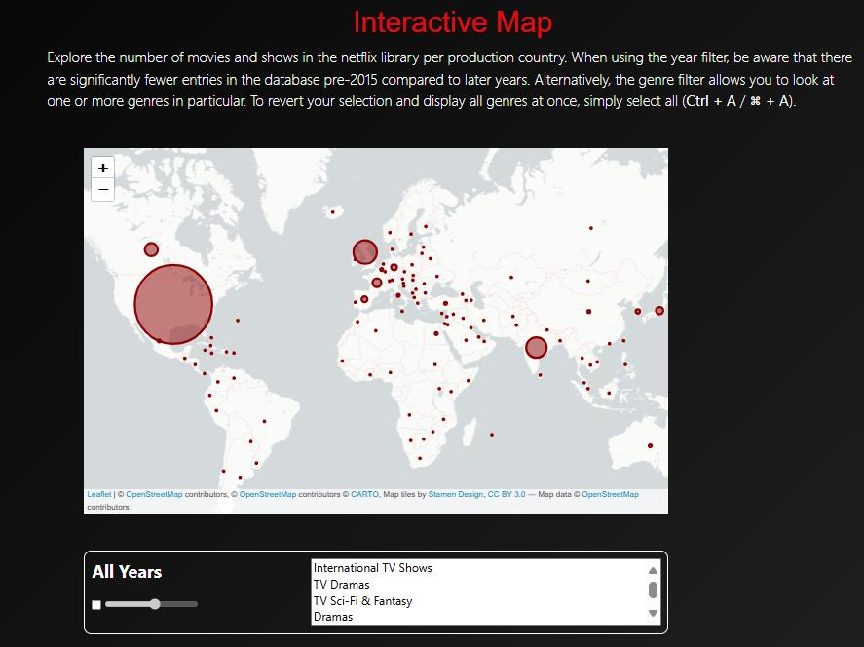
SCENCE 3

Slide 25

v. CONCLUSION
1. Achieved goals
This project aims to create comprehensive charts on Netflix viewers' viewing habits, utilizing interactive elements and a structured approach.
The dashboard will provide users with valuable insights, enabling them to make informed decisions and promote success in their fields.

Slide 26


v. CONCLUSION
2. Future work
Future work aims to enhance the dashboard's usability and functionality by adding detailed text descriptions, drill-down tools, interactive filters, and real-time data updates. This will enhance user experience and provide more insightful data analysis.

Slide 27

v. CONCLUSION
3. Concluding
We want to thank the lecturer for helping and supporting us.
We're grateful for the clear and well-documented resources that have helped us learn and grow.
We're excited to keep moving forward and learn more !
We also want to
congratulate the team members for working well together and achieving great
results through effective teamwork.
Our collaborative effort has resulted in creating a dashboard that's easy to use and helps people explore data in a better way.

Slide 28
VI. REFERENCES
1. Kaggle: Your Machine Learning and Data Science Community
2. Resources/css/stylemap.css
3. https://cdnjs.cloudflare.com/ajax/libs/twitterbootstrap/4.3.1/css/bootstrap.min.css
4. https://stackpath.bootstrapcdn.com/font-awesome/4.7.0/css/fontawesome.min.css
5. https://unpkg.com/leaflet@1.4.0/dist/leaflet.css

Slide 29
Game Presentation
thanks for
PLAYING
End

